Slide 1

Dynamic Programming
Read Chapter 3

Slide 2

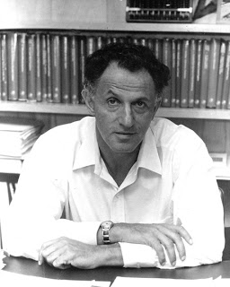
Quick Quiz Question
Why did the inventor of Dynamic Programming call it like this?
A. Dynamic memory allocation is used for solving the problems
B. Trees are created dynamically for solving the problems
C. Dynamically typed languages are used for implementation
D. It is just a good name, it is something not even a Congressman could object to
Richard Ernest Bellman
1920 –1984

Slide 3
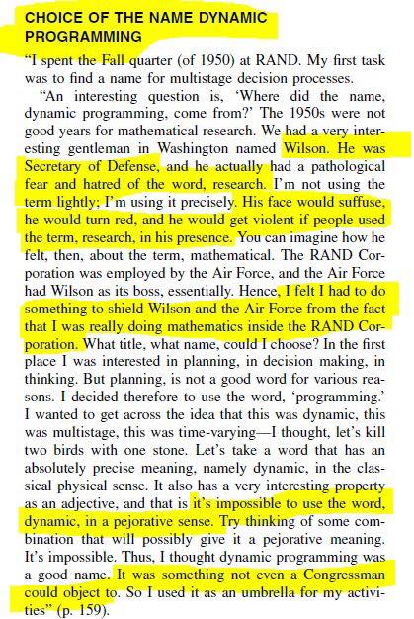
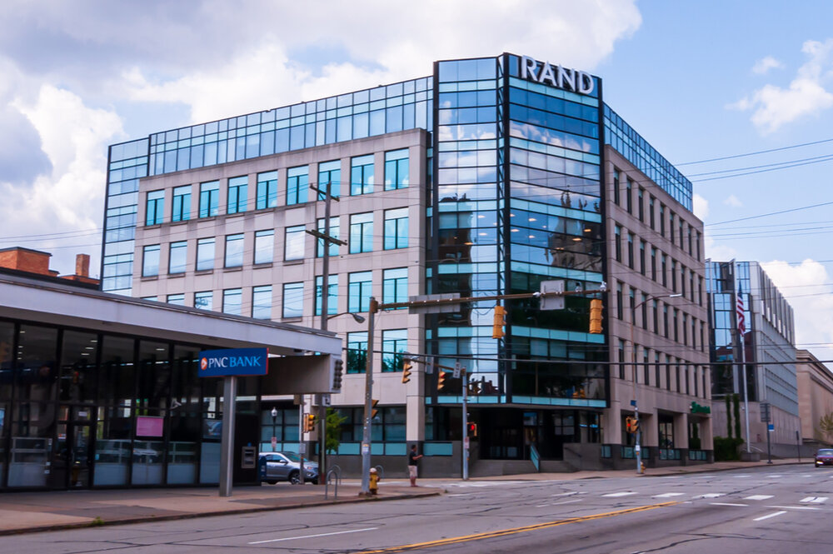
Why is it called Dynamic Programming?
Inventor: Richard E. Bellman, 1953
Bellman, R. (1953). An introduction to the theory of dynamic programming. RAND CORP, SANTA MONICA CA. https://apps.dtic.mil/sti/pdfs/AD0074903.pdf
Dynamic programming came from the term mathematical programming
Back in his day, the then secretary of defense was paranoid of the words Research and Math. Bellman was scared that the secretary would be furious at his work and eventually would get him into trouble. So he called it Dynamic Programming, however there's nothing 'dynamic' about it…
Typically on optimization problems (a problem with an objective)
Richard Ernest Bellman
1920 –1984

Slide 4
What is Dynamic Programming?
Basic idea: One implicitly explores the space of all possible solutions by
  carefully decomposing things into a series of sub problems
  building up correct solutions to larger and larger sub problems
Can you smell the Divide & Conquer flavor?
  However, Dynamic Programming is another story!
  Dynamic Programming does NOT exam all possible solutions explicitly

Slide 5
Dynamic Programming
Similar to divide-and-conquer in that the problem instance is divided into smaller instances
It is a bottom-up approach
  the small instances are solved first
  their result is saved and retrieved later when needed instead of being recomputed
Dynamic Programming includes 2 steps
  Establish a recursive property that gives the solution to an instance of the problem
  Solve an instance of the problem in a bottom-up fashion by solving smaller instances first
Dynamic programming sometimes
  provide an efficient solution to a problem
  for which divide-and-conquer produces an exponential run-time

Slide 6
The Binomial Coefficient
The number of combinations of k items that can be selected from a set of n items
Binomial Coefficient (Lecture-2/Appendix-A: the number of combinations of n objects taken k at a time) is given by
Computing the binomial coefficient by directly applying the above definition is not possible for large values of n and k, because n! is very large even for moderate values of n
Recursive property
We can eliminate the need to compute n! or k! by using this recursive property
n
k
n!
k! (n - k)!
=
For 0 ≤ k ≤ n
(
)
(
)
(
n - 1
)
(
n - 1
)
n
n
(
n
)
+
For 0 < k < n
= 1
= 1
k - 1
k
0
n
k
=
(
n
)
(
n - 1
)
(
n - 1
)
=
+
1
For k = 0 or k = n
k
k - 1
k

Slide 7
Finding the Recursive Property
The Binomial Coefficient (cont.)
n
k
=
=
=
=
=
+
=
+
=
+
n - 1
k - 1
n - 1
k
=
+

Slide 8
The Binomial Coefficient (cont.)
The recursive property suggests the following divide-and-conquer algorithm
Algorithm 3.1
  Binomial Coefficient Using Divide-and-Conquer
  Problem: Compute the binomial coefficient.
  Inputs: nonnegative integers n and k, where k ≤ n
  Outputs: bin, the binomial coefficient
Like Algorithm 1.6 (nth Fibonacci Term, Recursive), this algorithm is very inefficient
n
k
int bin (int n, int k)
{
if (k==0 II n==k)
return 1;
else
return bin(n-1, k-1) + bin(n-1, k);

Slide 9
The Binomial Coefficient (cont.)
The reason for the inefficiency is that same instances are solved in each recursive call
bin(n - 1, k - 1)
bin(n - 1, k)
  Thus bin(n-2, k-1) is solved separately in each recursive call
Both need the result of bin(n - 2, k - 1)
(
n
)
(
n
)
= 1
= 1
0
n
(
n
)
(
n - 1
)
(
n - 1
)
=
+
k
k - 1
k
Both need to compute
(
n - 2
)
k - 1

Slide 10
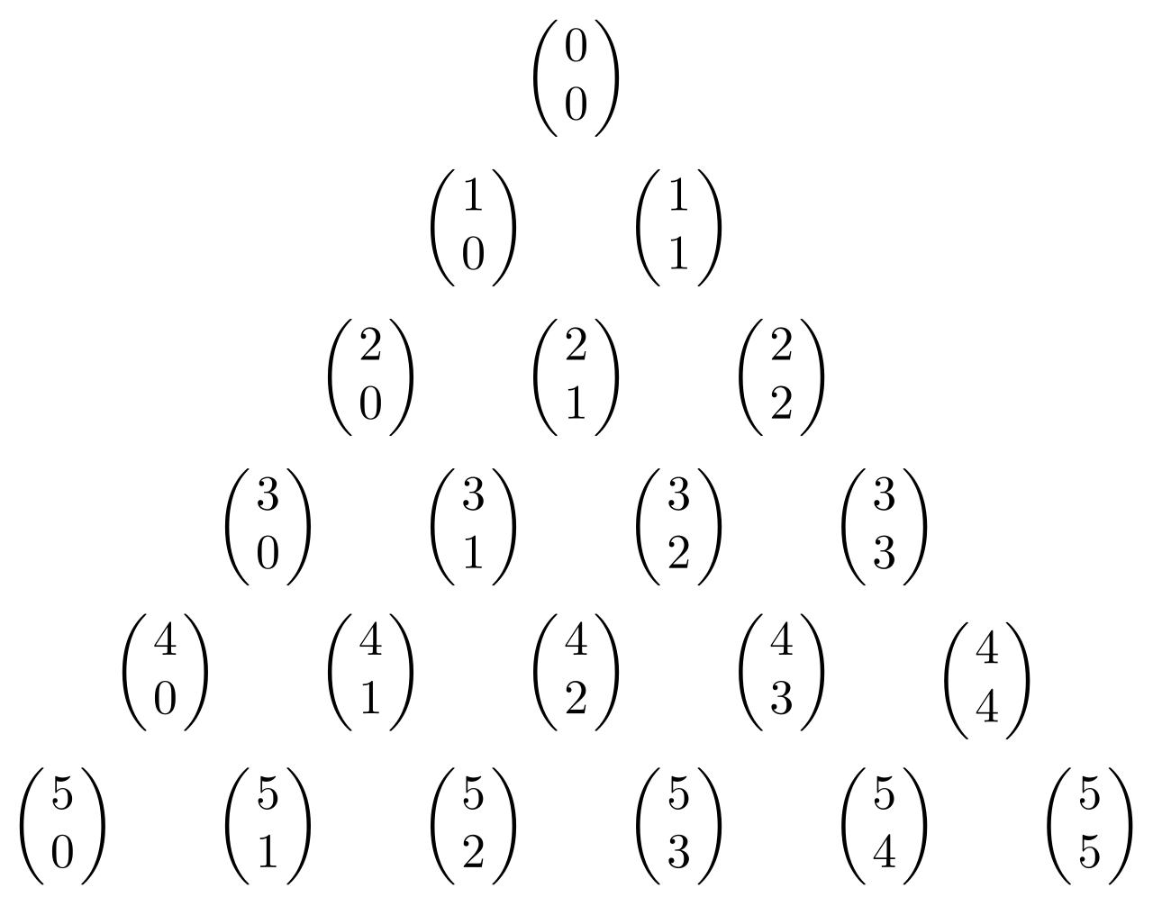
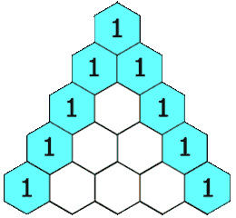
Dynamic Prg. For Binomial Coefficient
(
n
)
(
n - 1
)
(
n - 1
)
(
i
)
=
+
B[i] [j] will contain
k
k - 1
k
j
A dynamic programming algorithm for this problem
  Establish a recursive property. This has already been done in Equality 3.1
  1 j = 0 or j = i
  2. Solve an instance of the problem in a bottom-up fashion by computing the rows in B in sequence starting with the first row
B [i] [j] = B [i-1] [j-1] + B[i-1] [j] 0 < j < i
Pascal's triangle:
0 1 2 3 4 j k
0
1
2
3
4
i
n
1
1
1
1
1
1
2
3
4
1
3
6
1
4
1
+
=
B[i][j] = B[i-1][j-1] + B[i-1][j]
https://www.mathsisfun.com/pascals-triangle.html

Slide 11
The Binomial Coefficient (cont.)
(
4
)
B[i][j] = B[i-1][j-1] + B[i-1][j]
Example:
Compute B[4][2] =
2
1 If j=0 or i=j
Compute row 0:
B[0][0] = 1
Compute row 1:
B[1][0]=1
B[1][1]=1
Compute row 2:
B[2][0] = 1
B[2][1] = B[1][0] + B[1][1] = 1 + 1 = 2
B[2][2] = 1
Compute row 3:
B[3][0] = 1
B[3][1] = B[2][0]+B[2][1] = 1+2 = 3
B[3][2] = B[2][1]+B[2][2] = 2+1 = 3
Compute row 4:
B[4][0] = 1
B[4][1] = B[3][0] + B[3][1] = 1+3 = 4
B[4][2] = B[3][1] + B[3][2] = 3+3 = 6

Slide 12
The Binomial Coefficient (cont.)
Algorithm 3.2
  Binomial Coefficient Using Dynamic Programming
  Problem: Compute the binomial coefficient
  Inputs: nonnegative integers n and k, where k ≤ n
  Outputs: bin2, the binomial coefficient
n
k
int bin2 (int n, int k)
{
index i, j;
int B[0..n] [0..k];
for (i = 0; i <= n; i++)
for (j = 0; j <= minimum (i, k); j++)
if (j = = 0 || j = = i)
B[i][j] = 1;
else
B[i][j] = B[i - 1][j - 1] + B[i - 1] [j];
return B[n][k];
}

Slide 13
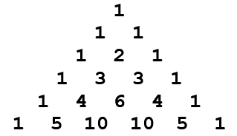
Analysis of the Algorithm
int bin2 (int n, int k)
{
index i, j;
int B[0..n] [0..k];
for (i = 0; i <= n; i++)
for (j = 0; j <= minimum (i, k); j++)
if (j = = 0 || j = = i)
B[i][j] = 1;
else
B[i][j] = B[i - 1][j - 1] + B[i - 1] [j];
return B[n[k];
}
Algorithm efficiency
  For given n and k, the number of passes through the for-j loop is shown in the following table for each value of i:
  The total number of passes is therefore given by
  This expression equals
n
k
i | 0 | 1 | 2 | 3 | … | k | k+1 | … | n
# of passes | 1 | 2 | 3 | 4 | … | k+1 | k+1 | … | k+1
1 + 2 + 3 + 4 + … + k + (k+1) + (k+1) … + (k+1)
n-k+1 times
k(k+1) / 2 + (n-k + 1) (k+1) = (2n-k+2) (k+1) / 2
ϵ ϴ( nk )

Slide 14
Wrap Up
By using dynamic programming instead of divide-and-conquer
  we have developed a much more efficient algorithm
Dynamic programming is similar to divide-and-conquer in that we find a recursive property that divides an instance into smaller instances
The difference is that in dynamic programming we use the recursive property to iteratively solve the instances in sequence, starting from the smallest instance
This way, we solve each smaller instance just once
Dynamic programming is a good technique to try when divide-and-conquer leads to an inefficient algorithm

Slide 15
Brief Review of Graph Theory - Terminology I
An Unweighted Undirected Graph
Graph: A graph consists of a set of vertices and a set of edges that connect pairs of vertices; G = (V, E) where V is a set of vertices, E a set of edges.
Vertex (node): Represents one of the objects that are connected together.
Edge (arc/link): Connection (line/link) between two vertices.
Directed Graph (Digraph): A graph where edges have a direction.
Undirected Graph: A graph where edges do not have a direction.
Adjacent Vertices: Two vertices are said to be adjacent, if there is an edge between the two vertices.
Weighted Graph: A graph where edges have values associated with them called weights.
Unweighted Graph: A graph where edges do not have weights.
Weighted Directed Graph: A graph where edges have a direction and a weight.
Unweighted Undirected Graph: A graph where edges do not have a direction and do not have a weight.
v₁
v₂
v₅
v₄
v₃
A Weighted Directed Graph
Weights
Edges (arcs)
Vertices
1
v₁
v₂
3
9
v₅
5
2
3
3
v₄
2
v₃
4

Slide 16
Graph Representation : Adjacency Matrix
A weighted graph containing n vertices can be represented by an Adjacency Matrix that can be implemented using a two dimensional array where
Weight on edge if there is an edge from v_{i} to v_{j}
∞ if there is no edge from v_{i} to v_{j}
0 if i = j
W[i][j] =
Elements of the matrix indicate whether pairs of vertices are adjacent or not in the graph.
1
Vertices
Adjacency Matrix
v₁
v₂
3
W | 1 | 2 | 3 | 4 | 5
1 | 0 | 1 | ∞ | 1 | 5
2 | 9 | 0 | 3 | 2 | ∞
3 | ∞ | ∞ | 0 | 4 | ∞
4 | ∞ | ∞ | 2 | 0 | 3
5 | 3 | ∞ | ∞ | ∞ | 0
Weights
on Edges
9
v₅
5
2
1
3
3
v₄
2
v₃
4

Slide 17
Graph Representation: Adjacency Matrix (cont.)
An unweighted undirected graph containing n vertices can also be represented by an Adjacency Matrix that can be implemented using a two dimensional array where
1 if there is an edge between v_{i} and v_{j}
0 if there is no edge between v_{i} and v_{j}
0 if i = j
W[i][j] =
The Adjacency Matrix is symmetric
Vertices
Adjacency Matrix
Unweighted Undirected Graph
W | 1 | 2 | 3 | 4 | 5
1 | 0 | 1 | 0 | 1 | 1
2 | 1 | 0 | 1 | 1 | 0
3 | 0 | 1 | 0 | 1 | 0
4 | 1 | 1 | 1 | 0 | 1
5 | 1 | 0 | 0 | 1 | 0
Edges
v₁
v₂
v₅
v₄
v₃

Slide 18
Brief Review of Graph Theory – Terminology II
Path: Sequence of vertices connected by edges. There is an edge from each vertex to its successor.
Simple path: A path is called simple if it never passes through the same vertex twice.
Length of a Path:
  Weighted graph: Sum of the weights on the path
  Unweighted graph: Number of edges in the path.
Cycle: A path from a vertex to itself. It is a path where the first and last vertices are the same.
Cyclic Graphs: A graph is cyclic if it contains a cycle.
Acyclic graphs: An acyclic graph is a graph that does not contain a cycle.
Tour (Hamiltonian Circuit): in a directed graph, it is a path from a vertex to itself that passes through each of the other vertices exactly once.
A Weighted Directed Graph
1
v₁
v₂
3
9
v₅
5
2
1
3
3
v₄
2
v₃
4
Cycle
Tour
Path

Slide 19
Applications of Graphs
Graphs are used as abstractions in many applications
Transportation Networks: Roads and intersections, cities and airports, …
Social Networks: Who is connected to who, …
Utility Graphs: Power grids, Internet, ...
Document links: Webpages and hyperlinks between pages, …
Semantic Networks: Words and relations/connections between them, …
Epidemiology: People and transfer of disease among people, …
Dependency Relations: Items/tasks and dependencies among them, …
Maze: Passages and intersections.

Slide 20
The Shortest Path Problem
1
v₁
v₂
3
9
v₅
5
2
Shortest path is an optimization problem
1
3
3
v₄
2
v₃
4
Paths from v₁ to v_{3:}
length [v₁ , v₂ , v₃] = 1 + 3 = 4
length [v₁ , v₄ , v₃] = 1 + 2 = 3 → Shortest path
length [v₁ , v₂ , v₄, v₃] = 1 + 2 + 2 = 5
Many candidate solutions
- Each candidate solution has a value associated with it
- The solution to the instance is any candidate solution that has an optimal value

Slide 21
Trivial Algorithm For Shortest Paths
Shortest path from v₁ to v₃ : There could be many optimal solutions. We need to find one of them.
Trivial Algorithm Idea
Determine length from each vertex
to all other vertex. Find path with
minimum length.
from v₁ to v₃ :
- from v₁ to all neighbor vertices
other than destination (adjacent
vertices): n-2 choices.
- from any of n-2 neighbors to their
neighbors, …etc. ( n-3 choices)
Total number of paths: (n-2) (n-3) (n-4)…. 1 = (n – 2) !
1
v₁
v₂
3
9
v₅
5
2
1
3
3
v₄
2
v₃
4
Worse than exponential!

Slide 22
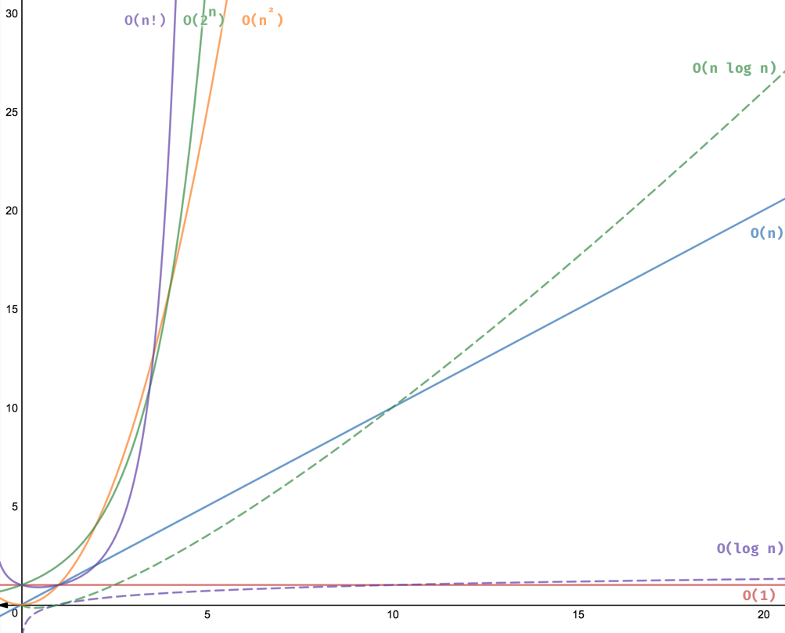
Dynamic Programming for the Shortest Paths Problem
We create a cubic-time algorithm for the Shortest Paths problem
First, we develop an algorithm that determines only the lengths of the shortest paths
After that, we modify it to produce shortest paths as well

Slide 23
Floyd’s Algorithm For Shortest Paths
W | 1 | 2 | 3 | 4 | 5
1 | 0 | 1 | ∞ | 1 | 5
2 | 9 | 0 | 3 | 2 | ∞
3 | ∞ | ∞ | 0 | 4 | ∞
4 | ∞ | ∞ | 2 | 0 | 3
5 | 3 | ∞ | ∞ | ∞ | 0
1
v₁
v₂
3
9
v₅
5
1
2
3
3
v₄
2
v₃
4
Problem: Compute D from W.
Solution: Create a sequence of n +1 arrays D^{(k)} , 0 ≤ k ≤ n, where
D^{(k)}[i][j] = length of shortest path from v_{i} to v_{j} using only vertices in the set {v₁, v₂, …, v_{k}} as intermediate vertices.
D | 1 | 2 | 3 | 4 | 5
1 | 0 | 1 | 3 | 1 | 4
2 | 8 | 0 | 3 | 2 | 5
3 | 10 | 11 | 0 | 4 | 7
4 | 6 | 7 | 2 | 0 | 3
5 | 3 | 4 | 6 | 4 | 0

Slide 24
Dynamic Programming for Shortest Path Problem
Dynamic programming steps
  - Establish a recursive property to compute D^{(k)} from D^{(k-1)}
  - Solve an instance of the problem in a bottom-up fashion using the recursive property
That is compute D⁽⁰⁾ then D⁽¹⁾ then …. then D^{(n)}
D⁽⁰⁾[i][j] = length of shortest path from v_{i} to v_{j} that is not allowed to pass through any other vertices.
= weight on the edge from v_{i} to v_{j}
D^{(n)}[i][j] = length of shortest path from v_{i} to v_{j} that is allowed to pass through any of the other vertices.
= length of shortest path v_{i} to v_{j}
Finding the recursive property: compute D^{(k)} from D^{(k-1)}
To do so, let’s to consider two cases
- Shortest path does not include vertex v_{k}
- Shortest path does include vertex v_{k}

Slide 25
Recurrence Property for Shortest Paths -I-
  D^{(k-1)}[i][j]
  D^{(k)}[i][j]
Shortest path between
v_{i} and v_{j} that considers
all vertices v₁, ... , v_{k-1}
v_{i}
v_{j}
v_{i}
v_{j}
vertices from v₁, ... , v_{k-1}
vertices from v₁, ... , v_{k-1} , v_{k}
Case 1: v_{k} not used
D^{(k)}[i][j] = D^{(k-1)}[i][j]
v_{i}
v_{j}
vertices from v₁, ... , v_{k}
Case 2: v_{k} is used
D^{(k)}[i][j] = D^{(k-1)}[i][k] + D^{(k-1)}[k][j]
v_{j}
v_{i}
v_{k}
vertices from v₁, ... , v_{k-1}
vertices from v₁, ... , v_{k-1}
  D^{(k)}[i][j] =
  Minimum length between
  Case 1 & Case 2

Slide 26
Recurrence Property for Shortest Paths -II-
We have either case 1 or case 2, then:
D^{(k)}[i][j] = minimum(D^{(k-1)}[i][j], D^{(k-1)}[i][k] + D^{(k-1)}[k][j])
Example :
D⁰ | 1 | 2 | 3 | 4 | 5
1 | 0 | 1 | ∞ | 1 | 5
2 | 9 | 0 | 3 | 2 | ∞
3 | ∞ | ∞ | 0 | 4 | ∞
4 | ∞ | ∞ | 2 | 0 | 3
5 | 3 | ∞ | ∞ | ∞ | 0
D¹ | 1 | 2 | 3 | 4 | 5
1 | 0 | 1 | ∞ | 1 | 5
2 | 9 | 0 | 3 | 2 | 14
3 | ∞ | ∞ | 0 | 4 | ∞
4 | ∞ | ∞ | 2 | 0 | 3
5 | 3 | 4 | ∞ | 4 | 0
D¹[2][4] = min(D⁰[2][4], D⁰[2][1] + D⁰[1][4]) = min(2,9+1) = 2
D¹[5][2] = min(D⁰[5][2], D⁰[5][1] + D⁰[1][2]) = min(∞,3+1) = 4
D¹[5][4] = min(D⁰[5][4], D⁰[5][1] + D⁰[1][4]) = min(∞,3+1) = 4

Slide 27
D⁰ | 1 | 2 | 3 | 4 | 5
1 | 0 | 1 | ∞ | 1 | 5
2 | 9 | 0 | 3 | 2 | ∞
3 | ∞ | ∞ | 0 | 4 | ∞
4 | ∞ | ∞ | 2 | 0 | 3
5 | 3 | ∞ | ∞ | ∞ | 0
D¹ | 1 | 2 | 3 | 4 | 5
1 | 0 | 1 | ∞ | 1 | 5
2 | 9 | 0 | 3 | 2 | 14
3 | ∞ | ∞ | 0 | 4 | ∞
4 | ∞ | ∞ | 2 | 0 | 3
5 | 3 | 4 | ∞ | 4 | 0
D² | 1 | 2 | 3 | 4 | 5
1 | 0 | 1 | 4 | 1 | 5
2 | 9 | 0 | 3 | 2 | 14
3 | ∞ | ∞ | 0 | 4 | ∞
4 | ∞ | ∞ | 2 | 0 | 3
5 | 3 | 4 | 7 | ? | 0
D³ | 1 | 2 | 3 | 4 | 5
1 | 0 | 1 | 4 | 1 | 5
2 | 9 | 0 | 3 | 2 | 14
3 | ∞ | ? | 0 | 4 | ∞
4 | ∞ | ∞ | 2 | 0 | 3
5 | 3 | 4 | 7 | 4 | 0
D⁴ | 1 | 2 | 3 | 4 | 5
1 | 0 | 1 | 3 | 1 | 4
2 | 9 | 0 | 3 | 2 | 5
3 | ∞ | ? | 0 | 4 | 7
4 | ∞ | ∞ | 2 | 0 | 3
5 | 3 | 4 | 6 | 4 | 0
D⁵ | 1 | 2 | 3 | 4 | 5
1 | 0 | 1 | 3 | 1 | 4
2 | 8 | 0 | 3 | 2 | 5
3 | 10 | ? | 0 | 4 | 7
4 | 6 | 7 | 2 | 0 | 3
5 | 3 | 4 | 6 | 4 | 0
D²[5][4] = ?
D⁴[5][3] = ?
D⁴[2][5] = ?
D⁴[3][2] = ?
D⁵[3][2] = ?

Slide 28
D¹ | 1 | 2 | 3 | 4 | 5
1 | 0 | 1 | ∞ | 1 | 5
2 | 9 | 0 | 3 | 2 | 14
3 | ∞ | ∞ | 0 | 4 | ∞
4 | ∞ | ∞ | 2 | 0 | 3
5 | 3 | 4 | ∞ | 4 | 0
D² | 1 | 2 | 3 | 4 | 5
1 | 0 | 1 | 4 | 1 | 5
2 | 9 | 0 | 3 | 2 | 14
3 | ∞ | ∞ | 0 | 4 | ∞
4 | ∞ | ∞ | 2 | 0 | 3
5 | 3 | 4 | 7 | 4 | 0
D³ | 1 | 2 | 3 | 4 | 5
1 | 0 | 1 | 4 | 1 | 5
2 | 9 | 0 | 3 | 2 | 14
3 | ∞ | ∞ | 0 | 4 | ∞
4 | ∞ | ∞ | 2 | 0 | 3
5 | 3 | 4 | 7 | 4 | 0
D⁴ | 1 | 2 | 3 | 4 | 5
1 | 0 | 1 | 3 | 1 | 4
2 | 9 | 0 | 3 | 2 | 5
3 | ∞ | ∞ | 0 | 4 | 7
4 | ∞ | ∞ | 2 | 0 | 3
5 | 3 | 4 | 6 | 4 | 0
D⁵ | 1 | 2 | 3 | 4 | 5
1 | 0 | 1 | 3 | 1 | 4
2 | 8 | 0 | 3 | 2 | 5
3 | 10 | 11 | 0 | 4 | 7
4 | 6 | 7 | 2 | 0 | 3
5 | 3 | 4 | 6 | 4 | 0
D²[5][4] = min(D¹[5][4], D¹[5][2] + D¹[2][4]) = min(4,4+2) = 4
D⁴[5][3] = min(D³[5][3], D³[5][4] + D³[4][3]) = min(7,4+2) = 6
D⁴[2][5] = min(D³[2][5], D³[2][4] + D³[4][5]) = min(14, 2+3) = 5
D⁴[3][2] = min(D³[3][2], D³[3][4] + D³[4][2]) = min(∞,4+ ∞) = ∞
D⁵[3][2] = min(D⁴[3][2], D⁴[3][5] + D⁴[5][2]) = min(∞,7+4) = 11

Slide 29
Floyd’s Algorithm For Shortest Paths
void floyd (int n, const number W[ ][ ],
number D[ ][ ])
{
index i,j,k;
D = W;
for (k = 1; k <= n; k++)
for (i = 1; i <= n; i++)
for (j = 1; j <= n; j++)
D[i][j] = min(D[i][j],D[i][k]+D[k][j]);
//D_{k}[i][j] = min(D_{k-1}[i][j],D_{k-1}[i][k]+D_{k-1}[k][j]);
}
Basic Operation:
Statement within inner for loop
Every Case Time complexity:
Loop within a loop within a loop.
Each loop is executed n times.
T(n) = n³ is in θ(n³)
Cover D⁽¹⁾ to D^{(n)}
Cover rows
Cover columns
for row i
W | 1 | 2 | 3 | 4 | 5
1 | 0 | 1 | ∞ | 1 | 5
2 | 9 | 0 | 3 | 2 | ∞
3 | ∞ | ∞ | 0 | 4 | ∞
4 | ∞ | ∞ | 2 | 0 | 3
5 | 3 | ∞ | ∞ | ∞ | 0
D | 1 | 2 | 3 | 4 | 5
1 | 0 | 1 | 3 | 1 | 4
2 | 8 | 0 | 3 | 2 | 5
3 | 10 | 11 | 0 | 4 | 7
4 | 6 | 7 | 2 | 0 | 3
5 | 3 | 4 | 6 | 4 | 0

Slide 30
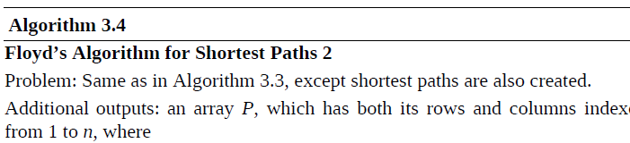

Floyd’s Algorithm For Shortest paths
void floyd2 (int n, const number W[ ][ ],
number D[ ][ ],
index P[ ][ ])
{
index i,j,k;
for (i = 1; i <= n; i++)
for (j = 1; j <= n; j++)
P[i][j] = 0;
D = W;
for (k = 1; k <= n; k++)
for (i = 1; i <= n; i++)
for (j = 1; j <= n; j++)
if (D[i][k]+D[k][j] < D[i][j]) {
P[i][j] = k;
D[i][j] = D[i][k]+D[k][j];
}
}
Pb: Previous Algo. finds the shortest path but no indication on the path itself (sequence of vertices).
Initialize P to 0
v_{k} is used in
shortest path
P | 1 | 2 | 3 | 4 | 5
1 | 0 | 0 | 4 | 0 | 4
2 | 5 | 0 | 0 | 0 | 4
3 | 5 | 5 | 0 | 0 | 4
4 | 5 | 5 | 0 | 0 | 0
5 | 0 | 1 | 4 | 1 | 0
Recursive property:
D[i][j] = min(D[i][j], D[i][k]+D[k][j]);

Slide 31
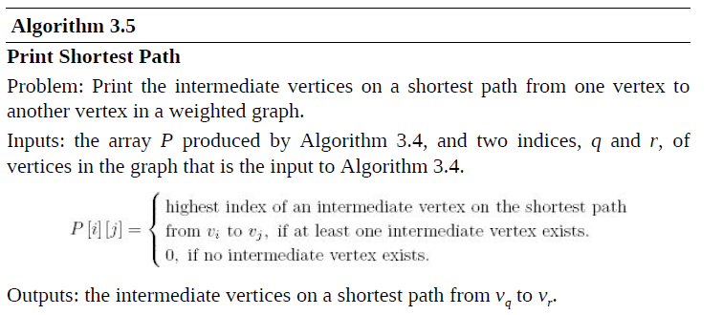
Printing the Shortest Path
Tracing the Execution of path(5,3)
Path(5,3)
Path(5,4)
cout << v₄
Path(4,3)
Path(5,1)
cout << v₁
Path(1,4)
1. path(5,3)
void path (index q, r)
{
if (P[q][r] != 0) {
path(q, P[q][r] );
cout << “v” << P[q][r];
path( P[q][r], r);
}
}
v₅
v₄
v₃
Test Run:
path(5,3)
path(5,4)
path(5,1)
v₁
path(1,4)
v₄
path(4,3)
v₅
v₄
v₃
1.1 path(5,4)
v₅
v₁
v₄
v₃
1.1.1 path(5,1)
1.1.2 cout << “v₁”
v₅
v₁
v₄
v₃
1.1.3 path(1,4)
1.2 cout << “v₄”
v₅
v₁
v₄
v₃
1.3 path(4,3)

Slide 32
Dynamic Programming and Optimization Problems
Dynamic Programming can be used to solve optimization problems such as the shortest path problem
Dynamic Programming for Optimization Problems
  requires a third step which is to construct the optimal solution
Thus, there must be 3 steps
  Establish a recursive property that gives the optimal solution of the problem
  Compute the optimal solution in a bottom-up fashion
  Construct the optimal solution in a bottom up fashion
Not every optimization problem can be solved using dynamic programming
Dynamic programming solves only those problems for which the principle of optimality holds

Slide 33
The Principle of Optimality
Def: The principle of optimality is said to apply in a problem if an optimal solution to an instance of a problem always contains optimal solutions to all sub instances
Principle of optimality: Suppose that in solving a problem, we have to make a sequence of decisions D₁, D₂, …, D_{n}. If this sequence is optimal, then the last k decisions, 1 < k < n must be optimal
e.g., the shortest path problem
If i, i₁, i₂, …,i_{k}, …, j is a shortest path from i to j, then the path i to i_{k} and i_{k} to j are also shortest paths

Slide 34
Dynamic Programming and Principle of Optimality
If the principle of optimality holds in a given problem, we can find a recursive property
The recursive property gives an optimal solution to an instance in terms of optimal solutions to smaller instances
Before using dynamic programming, it is necessary to show that the principle of optimality holds
1
v₂
4
v₁
v₄
Longest Path (only simple paths, no cycle!)
from v₁ to v₄ is [v₁,v₃,v₂,v₄]
However [v₁,v₃] is not longest path
from v₁ to v₃. Consider [v₁,v₂,v₃]
1
2
3
v₃
The principle of optimality does not apply in this example !

Slide 35
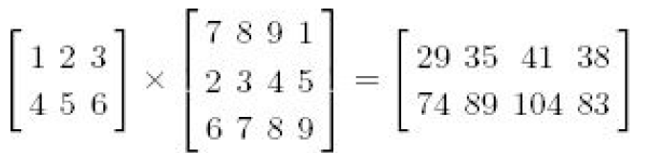
3.4. Chained Matrix Multiplication
3 elementary multiplications to compute each item (1*7 + 2 *2 + 3 * 6 =29)
There are 2 X 4 entries in the product, the total number of multiplication is given by 2 X 4 X 3 = 24 (in general i * j * k)
Consider the multiplication of these four matrices
A * B * C * D
20 x 2 2 x 30 30 x 12 12 x 8
Matrix multiplication is an associative operation
  The order in which we multiply does not matter
There are 5 different orders in which we can multiply four matrices

Slide 36
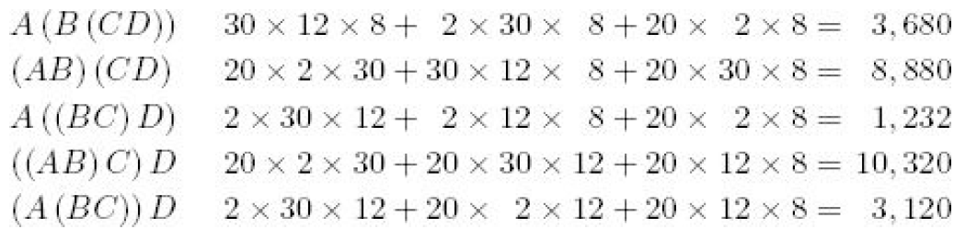
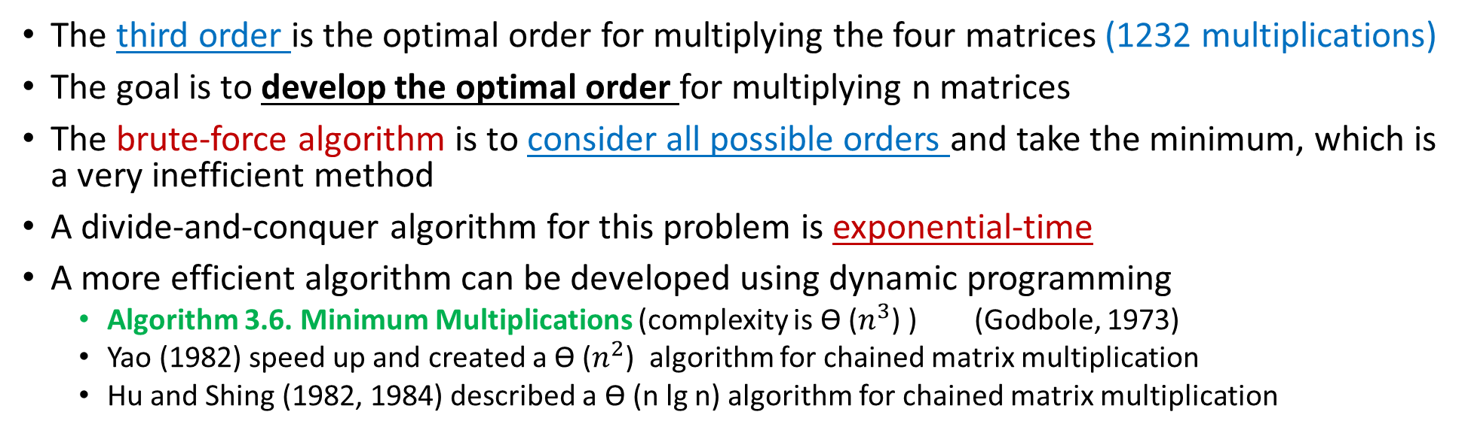
3.4. Chained Matrix Multiplication
The third order is the optimal order for multiplying the four matrices (1232 multiplications)
The goal is to develop the optimal order for multiplying n matrices
The brute-force algorithm is to consider all possible orders and take the minimum, which is a very inefficient method
A divide-and-conquer algorithm for this problem is exponential-time
A more efficient algorithm can be developed using dynamic programming
  Algorithm 3.6. Minimum Multiplications (complexity is ϴ ($n^{3}$) ) (Godbole, 1973)
  Yao (1982) speed up and created a ϴ ($n^{2}$) algorithm for chained matrix multiplication
  Hu and Shing (1982, 1984) described a ϴ (n lg n) algorithm for chained matrix multiplication

Slide 37
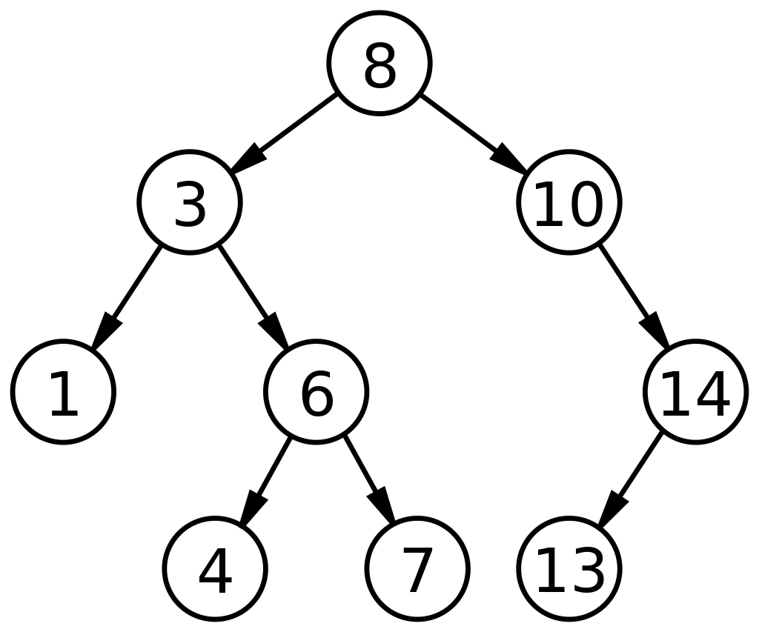
3.5. Optimal Binary Search Trees
A binary search tree (BST) is a binary tree of items that come from an ordered set such that
  Each node contains one key
  The keys in the left subtree of a given node are less than or equal to the key in that node
  The keys in the right subtree of a given node are greater than or equal to the key in that node
BST contains records that are retrieved according to the values of the keys
The goal is to organize the keys in a BST so that average time it takes to locate a key is minimized
A tree organized in this fashion is called optimal
In an optimal tree, all the keys have the same probability of being the search key
The number of comparisons done by procedure search to locate a key is called the search time

Slide 38

3.5. Optimal Binary Search Trees
The goal is to determine a tree for which the average search time is minimal
Algorithm 3.9. Optimal Binary Search Tree
  Complexity is ϴ ($n^{3}$) (Gilbert and Moore, 1959)
ϴ ($n^{2}$) algorithm can be obtained using the dynamic programming speed-up method in Yao (1982)

Slide 39
3.6. The Traveling Salesperson Problem
A salesman has a number of cities he must visit, find the shortest route (tour)
  Starts and ends at the same city
  Visits all cities
  Each city is visited exactly once
Possible tours from v₁ back to v₁
length [v₁ , v₂ , v₃ , v₄ , v₁] = 22
length [v₁ , v₃ , v₂ , v₄ , v₁] = 26
length [v₁ , v₃ , v₄ , v₂ , v₁] = 21 → Optimal (shortest) Tour
Traveling Salesperson problem is an optimization problem
Note: Starting city is irrelevant to the length of the optimal tour.
A Tour is a Cycle (Hamiltonian Circuit)
2
W | 1 | 2 | 3 | 4
1 | 0 | 2 | 9 | ∞
2 | 1 | 0 | 6 | 4
3 | ∞ | 7 | 0 | 8
4 | 6 | 3 | ∞ | 0
v₁
1
v₂
3
6
4
7
6
9
v₄
v₃
8

Slide 40
Trivial Algorithm For Traveling Salesperson
Shortest route from v₁ back to v₁ passing by all other vertices exactly once
There could be many optimal solutions. We need to find one of them
Trivial Algorithm Idea
Consider all possible tours and find the optimal one
- from v₁ to all neighbor vertices (adjacent vertices): (n-1) choices
- from any of n-1 neighbors to their neighbors, …etc. (n-2) choices
Total number of paths: (n-1)(n-2) …. 1 = (n - 1) !
All possible tours: (n-1)!
3 ! = 3 * 2 * 1 = 6
v₁
2
9
5
1st Level: n-1 choices
v₂
v₃
v₄
6
4
7
3
8
4
v₁
2
v₂
2nd Level: n-2 choices
v₃
v₄
v₂
v₄
v₃
v₂
1
3
8
4
4
7
6
4
4
9
4
7
6
3rd Level: n-3 choices
v₄
v₃
v₄
v₂
v₂
v₃
6
5
v₄
v₃
6
4
6
1
1
4
3
v₁
v₁
v₁
v₁
v₁
v₁
8
17
18
26
17
21
19

Slide 41
Traveling Salesperson and Dynamic Programming
Can dynamic programming be applied to this problem?
If v_{k} is the first vertex after v₁ on an optimal tour
Subpath from v_{k} to v₁ must be the
shortest path from v_{k} to v₁ that passes through
the other vertices exactly once
The principle of optimality holds
2
v₁
1
v₂
3
6
4
7
6
9
v₄
v₃
8
Dynamic Programming can be applied to this problem

Slide 42
Traveling Salesperson: Finding The Recursive Property
2
v₁
1
v₂
3
v₁
6
4
7
6
9
v₄
v₃
v₂
v₃
v₄
8
v₃
v₄
v₂
v₄
v₃
v₂
W | 1 | 2 | 3 | 4
1 | 0 | 2 | 9 | ∞
2 | 1 | 0 | 6 | 4
3 | ∞ | 7 | 0 | 8
4 | 6 | 3 | ∞ | 0
v₄
v₃
v₄
v₂
v₂
v₃
v₁
v₁
v₁
v₁
v₁
v₁
Solve in a Bottom up fashion: Start from bottom of the tree and solve as you move up

Slide 43
Traveling Salesperson: Finding The Recursive Property (cont.)
2
v₁
1
v₂
3
v₁
6
4
7
6
9
v₄
v₃
v₂
v₃
v₄
8
v₃
v₄
v₂
v₄
v₃
v₂
W | 1 | 2 | 3 | 4
1 | 0 | 2 | 9 | ∞
2 | 1 | 0 | 6 | 4
3 | ∞ | 7 | 0 | 8
4 | 6 | 3 | ∞ | 0
Distance to go
from 4 to 1 = 6
∞
6
1
1
∞
6
v₄
v₃
v₄
v₂
v₂
v₃
v₁
v₁
v₁
v₁
v₁
v₁
Solve in a Bottom up fashion: Start from bottom of the tree and solve as you move up

Slide 44
Traveling Salesperson: Finding The Recursive Property (cont.)
2
v₁
1
v₂
3
v₁
6
4
7
6
9
v₄
v₃
v₂
v₃
v₄
8
8+6=14
∞+∞=∞
4+6=10
3+1=4
7+1=8
6+∞=∞
Distance from 3 to 1 =
from 3 to 4 + 4 to 1 =
8 + 6 = 14
v₃
v₄
v₂
v₄
v₃
v₂
W | 1 | 2 | 3 | 4
1 | 0 | 2 | 9 | ∞
2 | 1 | 0 | 6 | 4
3 | ∞ | 7 | 0 | 8
4 | 6 | 3 | ∞ | 0
Distance to go
from 4 to 1 = 6
∞
6
1
1
∞
6
v₄
v₃
v₄
v₂
v₂
v₃
v₁
v₁
v₁
v₁
v₁
v₁
Solve in a Bottom up fashion: Start from bottom of the tree and solve as you move up

Slide 45
Traveling Salesperson: Finding The Recursive Property (cont.)
2
v₁
1
v₂
3
Distance from 2 to 1 =
minimum of:
from 2 to 3 + 3 to 1 =
from 2 to 4 + 4 to 1 =
v₁
6
4
7
6
9
min( 6+14 , 4+∞ ) = 20
min( 7+10 , 8+4 ) = 12
min( ∞+8 , 3+∞ )=∞
v₄
v₃
v₂
v₃
v₄
8
8+6=14
∞+∞=∞
4+6=10
3+1=4
7+1=8
6+∞=∞
Distance from 3 to 1 =
from 3 to 4 + 4 to 1 =
8 + 6 = 14
v₃
v₄
v₂
v₄
v₃
v₂
W | 1 | 2 | 3 | 4
1 | 0 | 2 | 9 | ∞
2 | 1 | 0 | 6 | 4
3 | ∞ | 7 | 0 | 8
4 | 6 | 3 | ∞ | 0
Distance to go
from 4 to 1 = 6
∞
6
1
1
∞
6
v₄
v₃
v₄
v₂
v₂
v₃
v₁
v₁
v₁
v₁
v₁
v₁
Solve in a Bottom up fashion: Start from bottom of the tree and solve as you move up

Slide 46
Traveling Salesperson: Finding The Recursive Property (cont.)
2
v₁
1
v₂
min( 2+20 , 9+12, ∞+∞ ) = 21
3
Distance from 2 to 1 =
minimum of:
from 2 to 3 + 3 to 1 =
from 2 to 4 + 4 to 1 =
v₁
6
4
7
6
9
min( 6+14 , 4+∞ ) = 20
min( 7+10 , 8+4 ) = 12
min( ∞+8 , 3+∞ )=∞
v₄
v₃
v₂
v₃
v₄
8
8+6=14
∞+∞=∞
4+6=10
3+1=4
7+1=8
6+∞=∞
Distance from 3 to 1 =
from 3 to 4 + 4 to 1 =
8 + 6 = 14
v₃
v₄
v₂
v₄
v₃
v₂
W | 1 | 2 | 3 | 4
1 | 0 | 2 | 9 | ∞
2 | 1 | 0 | 6 | 4
3 | ∞ | 7 | 0 | 8
4 | 6 | 3 | ∞ | 0
Distance to go
from 4 to 1 = 6
∞
6
1
1
∞
6
v₄
v₃
v₄
v₂
v₂
v₃
v₁
v₁
v₁
v₁
v₁
v₁
Solve in a Bottom up fashion: Start from bottom of the tree and solve as you move up

Slide 47
Traveling Salesperson: Finding The Recursive Property
Distance from v₁ to v₁ passing by the set of vertices {v₂,v₃,v₄}: D[ v₁, {v₂,v₃,v₄} ]
D[ v₁, {v₂,v₃,v₄} ] = minimum ( W[1][j] + D[ j , {v₂,v₃,v₄} - {v_{j}}] )
2
v₁
1
v₂
2 ≤ j ≤ n
3
6
4
7
6
min( 2+20 , 9+12, ∞+∞ ) = 21
Distance from 2 to 1 =
minimum of:
from 2 to 3 + 3 to 1 =
from 2 to 4 + 4 to 1 =
v₁
9
v₄
v₃
8
min( 6+14 , 4+∞ ) = 20
min( 7+10 , 8+4 ) = 12
min( ∞+8 , 3+∞ )=∞
v₂
v₃
v₄
W | 1 | 2 | 3 | 4
1 | 0 | 2 | 9 | ∞
2 | 1 | 0 | 6 | 4
3 | ∞ | 7 | 0 | 8
4 | 6 | 3 | ∞ | 0
8+6=14
∞+∞=∞
4+6=10
3+1=4
7+1=8
6+∞=∞
Distance from 3 to 1 =
from 3 to 4 + 4 to 1 =
8 + 6 = 14
v₃
v₄
v₂
v₄
v₃
v₂
Distance to go
from 4 to 1 = 6
∞
6
1
1
∞
6
v₄
v₃
v₄
v₂
v₂
v₃
v₁
v₁
v₁
v₁
v₁
v₁
Solve in a Bottom up fashion: Start from bottom of the tree and solve as you move up

Slide 48
Traveling Salesperson: The Recursive Property
2
In the studied example:
Distance from v₁ to v₁ passing by the set of all other vertices {v₂,v₃,v₄}: D[ v₁, {v₂,v₃,v₄} ]
D[ v₁, {v₂,v₃,v₄} ] = minimum ( W[1][j] + D[ j , {v₂,v₃,v₄} - {v_{j}} ] )
v₁
1
v₂
3
2 ≤ j ≤ 4
6
4
7
6
9
In general:
Length of an optimal tour = minimum ( W[1][j] + D[v_{j}][V-{v₁ , v_{j}}] )
v₄
v₃
8
2 ≤ j ≤ n
Let:
V = Set of all vertices
A = A subset of V.
D[v_{i}][A] = length of a shortest path from v_{i} to v₁ passing through each vertex in A exactly once.
W | 1 | 2 | 3 | 4
1 | 0 | 2 | 9 | ∞
2 | 1 | 0 | 6 | 4
3 | ∞ | 7 | 0 | 8
4 | 6 | 3 | ∞ | 0
In general for i ≠ 1 and i not in A :
D[v_{i}][A] = minimum ( W[i][j] + D[v_{j}][A-{v_{j}}] ) if A ≠ ∅
j: v_{j} ∈ A
D[v_{i}][∅] = W[i][1]

Slide 49
Traveling Salesperson: Applying The Recursive Property
2
v₁
1
v₂
D[v_{i}][A] = minimum ( W[i][j] + D[v_{j}][A-{v_{j}}] ) if A ≠ ∅
3
j: v_{j} ∈ A
6
4
7
6
D[v_{i}][∅] = W[i][1]
9
v₄
v₃
8
Let: V = {v₁ , v₂ , v₃ , v₄}.
If A = {v₃} then,
D[v₂][A] = length[v₂ , v₃ , v₁] = ∞
If A = {v₃ ,v₄} then,
D[v₂][A] = minimum(length[v₂ , v₃ , v₄ , v₁], length[v₂ , v₄ , v₃ , v₁])
= minimum(6+8+6, 4+∞+∞) = minimum(20,∞) = 20
W | 1 | 2 | 3 | 4
1 | 0 | 2 | 9 | ∞
2 | 1 | 0 | 6 | 4
3 | ∞ | 7 | 0 | 8
4 | 6 | 3 | ∞ | 0

Slide 50
Traveling Salesperson: Recursive Property Explained
D[v_{i}][A] = minimum ( W[i][j] + D[v_{j}][A-{v_{j}}] ) if A ≠ ∅
2
j: v_{j} ∈ A
v₁
1
v₂
D[v_{i}][∅] = W[i][1]
3
6
4
7
6
Use n-1 = 3 intermediate vertices:
D[1] [ {v₂ , v₃ , v₄} ]
v₁
9
v₄
v₃
8
D[2] [ {v₃ , v₄} ]
D[3] [ {v₂ , v₄} ]
D[4] [ {v₂ ,v₃} ]
Only 2 intermediate vertices:
v₂
v₃
v₄
D[3] [{v₄}]
D[4] [{v₃}]
D[2] [{v₄}]
D[4] [{v₂}]
D[3] [{v₂}]
D[2] [{v₃}]
W | 1 | 2 | 3 | 4
1 | 0 | 2 | 9 | ∞
2 | 1 | 0 | 6 | 4
3 | ∞ | 7 | 0 | 8
4 | 6 | 3 | ∞ | 0
Only 1 intermediate vertex:
v₃
v₄
v₂
v₄
v₃
v₂
D[4][∅]
D[3][∅]
D[4][∅]
D[2][∅]
D[2][∅]
D[3][∅]
No intermediate vertices: D[i][∅]
D [i] [∅] = W [i] [1]
v₄
v₃
v₄
v₂
v₂
v₃
v₁
v₁
v₁
v₁
v₁
v₁
Solve in a Bottom up fashion: Start from bottom of the tree and solve as you move up

Slide 51
Traveling Salesperson: Use The Recursive Property to Find Optimal Tour
2
W | 1 | 2 | 3 | 4
1 | 0 | 2 | 9 | ∞
2 | 1 | 0 | 6 | 4
3 | ∞ | 7 | 0 | 8
4 | 6 | 3 | ∞ | 0
v₁
1
v₂
Recursive property:
3
D[v_{i}][A] = minimum ( W[i][j] + D[v_{j}][A-{v_{j}}] ) if A ≠ ∅
6
4
7
6
j: v_{j} ∈ A
9
v₄
v₃
D[v_{i}][∅] = W[i][1]
8
Solve in a Bottom up fashion:
Consider all sets with 1 element :
D[v₃][{v₂}] = minimum ( W[3][j] + D[v_{j}][{v₂} - {v_{j}}] )
= W[3][2] + D[v₂][∅] = 7 + 1 = 8
D[v₄][{v₂}] = 4
D[v₂][{v₃}] = ∞
D[v₄][{v₃}] = ∞
D[v₂][{v₄}] = 10
D[v₃][{v₄}] = 14
Consider the empty set :
D[v₂][∅] = 1
D[v₃][∅] = ∞
D[v₄][∅] = 6
j: v_{j}∈{v₂}

Slide 52
Use The Recursive Property to Find the Optimal Tour
2
W | 1 | 2 | 3 | 4
1 | 0 | 2 | 9 | ∞
2 | 1 | 0 | 6 | 4
3 | ∞ | 7 | 0 | 8
4 | 6 | 3 | ∞ | 0
v₁
1
v₂
D[v₃][{v₂}] = 8
D[v₄][{v₂}] = 4
D[v₂][{v₃}] = ∞
D[v₄][{v₃}] = ∞
D[v₂][{v₄}] = 10
D[v₃][{v₄}] = 14
3
6
4
7
6
9
v₄
v₃
8
Consider all sets with 2 elements :
D[v₄][{v₂ ,v₃}] = minimum ( W[4][j] + D[v_{j}][{v₂ , v₃} - {v_{j}}] )
= minimum (W[4][2] + D[v₂][{v₃}], W[4][3] + D[v₃][{v₂}])
= minimum (3 + ∞, ∞ + 8) = ∞
D[v₃][{v₂ ,v₄}] = minimum (7 + 10, 8 + 4) = 12
D[v₂][{v₃ ,v₄}] = minimum (6 + 14, 4 + ∞) = 20
j:v_{j}∈{v_{2 ,}v₃}

Slide 53
Use The Recursive Property to Find the Optimal Tour
2
W | 1 | 2 | 3 | 4
1 | 0 | 2 | 9 | ∞
2 | 1 | 0 | 6 | 4
3 | ∞ | 7 | 0 | 8
4 | 6 | 3 | ∞ | 0
v₁
1
v₂
3
6
4
7
6
9
v₄
v₃
8
Compute the length of the optimal tour: (set with 3 elements)
D[v₁][{v₂ ,v₃ ,v₄}] = minimum ( W[1][j] + D[v_{j}][{v₂ , v₃ , v₄} - {v_{j}}] )
= minimum ( W[1][2] + D[v₂][{v₃ , v₄}],
W[1][3] + D[v₃][{v₂ , v₄}],
W[1][4] + D[v₄][{v₂ , v₃}] )
= minimum (2 + 20, 9 + 12, ∞ + ∞) = 21
v_{j}∈{v_{2 ,}v_{3 ,}v₄}

Slide 54
Traveling Salesperson’ Algorithm
2
W | 1 | 2 | 3 | 4
1 | 0 | 2 | 9 | ∞
2 | 1 | 0 | 6 | 4
3 | ∞ | 7 | 0 | 8
4 | 6 | 3 | ∞ | 0
void travel (int n, const number W[ ][ ], index P[ ][ ],
number& minlength)
{
index i,j,k;
number D[1..n][subset of V - {v₁}]
for (i = 2; i <= n; i++)
D[i][∅] = W[i][1];
for (k = 1; k <= n-2; k++)
for (all subsets A ⊆ V - {v₁} containing k vertices)
for (i such that i ≠ 1 and v_{i} is not in A) {
D[i][A] = minimum(W[i][j] + D[j][A-{v_{j}}])
P[i][A] = value of j that gave the minimum;
}
D[1][V - {v₁}] = minimum(W[1][j]+D[j][V- {v₁,v_{j}}];
P[1][V - {v₁}] = value of j that gave the minimum;
minlength = D[1][V - {v₁}];
}
v₁
1
v₂
3
6
4
7
6
9
v₄
v₃
8
v₁
D[2] [ {v₃ , v₄} ]
2
9
5
v₂
v₃
v₄
j: v_{j} ∈ A
6
4
7
3
8
4
D[3] [{v₄}]
v₃
v₄
v₂
v₄
v₃
v₂
3
8
4
4
7
6
2 ≤ j ≤ n
D[4][∅]
v₄
v₃
v₄
v₂
v₂
v₃
6
4
6
1
1
4
v₁
v₁
v₁
v₁
v₁
v₁
17
18
26
17
21
19

Slide 55
Traveling Salesperson’ Algorithm
void travel (int n, const number W[ ][ ],
index P[ ][ ],
number& minlength)
{
index i,j,k;
number D[1..n][subset of V - {v₁}]
for (i = 2; i <= n; i++)
D[i][∅] = W[i][1];
for (k = 1; k <= n-2; k++)
for (all subsets A ⊆ V - {v₁} containing k vertices)
for (i such that i ≠ 1 and v_{i} is not in A) {
D[i][A] = minimum(W[i][j] + D[j][A-{v_{j}}])
P[i][A] = value of j that gave the minimum;
}
D[1][V - {v₁}] = minimum(W[1][j]+D[j][V- {v₁,v_{j}}];
P[1][V - {v₁}] = value of j that gave the minimum;
minlength = D[1][V - {v₁}];
}
Subsets A of V - {v₁} with
k vertices =
n - 1
k
Executed (n - 1 - k) times,
A has k vertices and i is not
in A ➔(n-k) and i ≠ 1 ➔ n - k - 1
Executed k times, since A
has k vertices.
j:v_{j}∈A
n-2
T(n) = (n-k-1) k
T(n) = (n-1)(n-2)2^{n-3} ∈θ(n² 2^{n})
∑
n - 1
k
k=1
2≤ j≤n

Slide 56


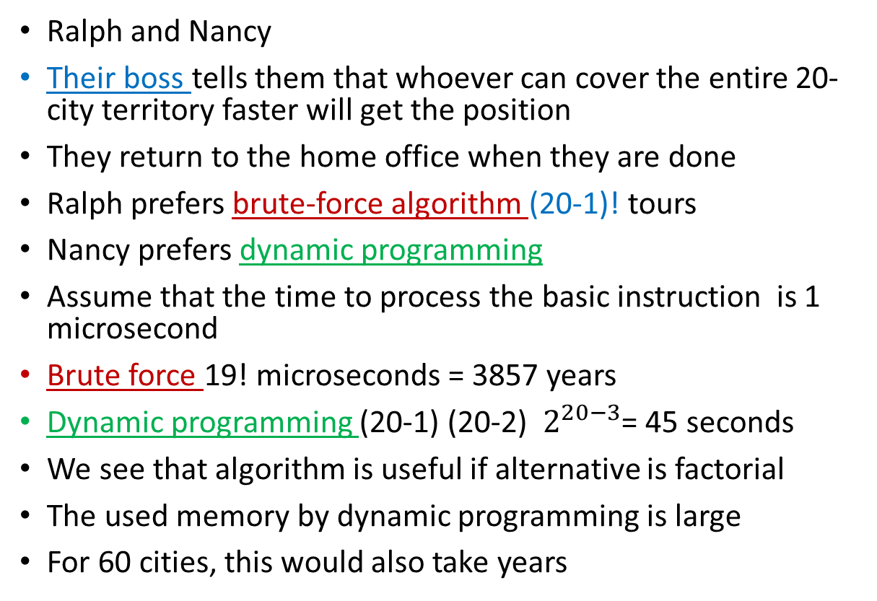
Is this algorithm useful? A case study
Ralph and Nancy
Their boss tells them that whoever can cover the entire 20-city territory faster will get the position
They return to the home office when they are done
Ralph prefers brute-force algorithm (20-1)! tours
Nancy prefers dynamic programming
Assume that the time to process the basic instruction is 1 microsecond
Brute force 19! microseconds = 3857 years
Dynamic programming (20-1) (20-2) $2^{20−3}$= 45 seconds
We see that algorithm is useful if alternative is factorial
The used memory by dynamic programming is large
For 60 cities, this would also take years

Slide 57
Note about Traveling Salesperson problem
No one has ever found an algorithm for this problem whose worst-case time complexity is better than exponential
Yet no one has ever proved that such an algorithm is not possible

Slide 58
Test Run of the Traveling Salesperson’ Algorithm
For A = Ø:
D[v₂][Ø] = 3
D[v₃][Ø] = 4
D[v₄][Ø] = 6
D[v₅][Ø] = 10
For A = 1 element:
D[v₃][{v₂}] = W[3][2] + D[v₂][Ø] = 11 + 3 = 14
D[v₄][{v₂}] = W[4][2] + D[v₂][Ø] = 6 + 3 = 9
D[v₅][{v₂}] = W[5][2] + D[v₂][Ø] = 6 + 3 = 9
D[v₂][{v₃}] = W[2][3] + D[v₃][Ø] = 7 + 4 = 11
D[v₄][{v₃}] = W[4][3] + D[v₃][Ø] = 7 + 4 = 11
D[v₅][{v₃}] = W[5][3] + D[v₃][Ø] = 2 + 4 = 6
D[v₂][{v₄}] = W[2][4] + D[v₄][Ø] = 8 + 6 = 14
D[v₃][{v₄}] = W[3][4] + D[v₄][Ø] = 10 + 6 = 16
D[v₅][{v₄}] = W[5][4] + D[v₄][Ø] = 1 + 6 = 7
D[v₂][{v₅}] = W[2][5] + D[v₅][Ø] = 10 + 10 = 20
D[v₃][{v₅}] = W[3][5] + D[v₅][Ø] = 7 + 10 = 17
D[v₄][{v₅}] = W[4][5] + D[v₅][Ø] = 11 + 10 = 21
Initial Adjacency Matrix:
1 2 3 4 5
Steps for optimal tour from v₁ to v₁
In General if A ≠ Ø:
D[v_{i}][A] = min(W[i][j] + D[v_{j}][A-{v_{j}}])
Otherwise if A = Ø:
D[v_{i}][Ø] = W[i][1]

Slide 59
For A = 2 elements:
D[v₄][ { v_{2,} v₃} ] = min ( W[4][2] + D[v₂][ {v₃} ], W[4][3] + D[v₃][ {v₂} ] )
= min ( 6 + 11, 7 + 14 ) = min ( 17, 21 ) = 17
D[v₅][ { v_{2,} v₃} ] = min ( W[5][2] + D[v₂][ {v₃} ], W[5][3] + D[v₃][ {v₂} ] )
= min ( 6 + 11, 2 + 14 ) = min ( 17, 16 ) = 16
D[v₃][ { v_{2,} v₄} ] = min ( W[3][2] + D[v₂][ {v₄} ], W[3][4] + D[v₄][ {v₂} ] )
= min ( 11 + 14, 10 + 9 ) = min ( 25, 19 ) = 19
D[v₅][ { v_{2,} v₄} ] = min ( W[5][2] + D[v₂][ {v₄} ], W[5][4] + D[v₄][ {v₂} ] )
= min ( 6 + 14, 1 + 9 ) = min ( 20, 10 ) = 10
D[v₃][ { v_{2,} v₅} ] = min ( W[3][2] + D[v₂][ {v₅} ], W[3][5] + D[v₅][ {v₂} ] )
= min ( 11 + 20, 7 + 9 ) = min ( 31, 16 ) = 16
D[v₄][ { v_{2,} v₅} ] = min ( W[4][2] + D[v₂][ {v₅} ], W[4][5] + D[v₅][ {v₂} ] )
= min ( 6 + 20, 11 + 9 ) = min ( 26, 20 ) = 20
D[v₂][ { v_{3,} v₄} ] = min ( W[2][3] + D[v₃][ {v₄} ], W[2][4] + D[v₄][ {v₃} ] )
= min ( 7 + 16, 8 + 11 ) = min ( 23, 19 ) = 19
D[v₅][ { v_{3,} v₄} ] = min ( W[5][3] + D[v₃][ {v₄} ], W[5][4] + D[v₄][ {v₃} ] )
= min ( 2 + 16, 1 + 11 ) = min ( 18, 12 ) = 12
D[v₂][ { v_{3,} v₅} ] = min ( W[2][3] + D[v₃][ {v₅} ], W[2][5] + D[v₅][ {v₃} ] )
= min ( 7 + 17, 10 + 6 ) = min ( 24, 16 ) = 16
D[v₄][ { v_{3,} v₅} ] = min ( W[4][3] + D[v₃][ {v₅} ], W[4][5] + D[v₅][ {v₃} ] )
= min ( 7 + 17, 11 + 6 ) = min ( 24, 17 ) = 17

Slide 60
D[v₂][ { v_{4,} v₅} ] = min ( W[2][4] + D[v₄][ {v₅} ], W[2][5] + D[v₅][ {v₄} ] )
= min ( 8 + 21, 10 + 7 ) = min ( 29, 17 ) = 17
D[v₃][ { v_{4,} v₅} ] = min ( W[3][4] + D[v₄][ {v₅} ], W[3][5] + D[v₅][ {v₄} ] )
= min ( 10 + 21, 7 + 7 ) = min ( 31, 14 ) = 14
A = 3 elements:
D[v₂][{ v_{3,} v_{4,} v₅}] = min (W[2][3] + D[v₃][{v_{4,} v₅}], W[2][4] + D[v₄][{v_{3,} v₅}], W[2][5] + D[v₅][{v_{3,} v₄}])
= min ( 7 + 14, 8 + 17, 10 + 12) = min ( 21, 25, 22 ) = 21
D[v₃][ { v_{2,} v_{4,} v₅} ] = min (W[3][2] + D[v₂][ {v_{4,} v₅} ], W[3][4] + D[v₄][ {v_{2,} v₅} ], W[3][5] + D[v₅][ {v_{2,} v₄}] )
= min ( 11 + 17, 10 + 20, 7 + 10) = min ( 28, 30, 17 ) = 17
D[v₄][ { v_{2,} v_{3,} v₅} ] = min (W[4][2] + D[v₂][ {v_{3,} v₅} ], W[4][3] + D[v₃][ {v_{2,} v₅} ], W[4][5] + D[v₅][ {v_{2,} v₃}] )
= min ( 6 + 16, 7 + 16, 11 + 16) = min ( 22, 23, 27 ) = 21
D[v₅][ { v_{2,} v_{3,} v₄} ] = min (W[5][2] + D[v₂][ {v_{3,} v₄} ], W[5][3] + D[v₃][ {v_{2,} v₄} ], W[5][4] + D[v₄][ {v_{2,} v₃}] )
= min ( 6 + 19, 2 + 19, 1 + 17) = min ( 25, 21, 18 ) = 18

Slide 61
A = 4 elements (find shortest path):
D[v₁][{ v_{2,} v_{3,} v_{4,} v₅ }] = min (W[1][2] + D[v₂][{v_{3,} v_{4,} v₅}], W[1][3] + D[v₃][{v_{2,} v_{4,} v₅}],
W[1][4] + D[v₄][{v_{2,} v_{3,} v₅}], W[1][5] + D[v₅][{v_{2,} v_{3,} v₄}] )
= min (8 + 21, 13 + 17, 18 + 21, 20 + 18)
= min (29, 30, 39, 38) = 29
Therefore the shortest tour is: (by tracing through paths in bold and underlined)
[v₁ , v₂ , v₃ , v₅ , v₄ , v₁ ] = 29
D[v₂][{ v_{3,} v_{4,} v₅}] = min (W[2][3] + D[v₃][{v_{4,} v₅}], W[2][4] + D[v₄][{v_{3,} v₅}], W[2][5] + D[v₅][{v_{3,} v₄}])
= min ( 7 + 14, 8 + 17, 10 + 12) = min ( 21, 25, 22 ) = 21
D[v₃][ { v_{4,} v₅} ] = min ( W[3][4] + D[v₄][ {v₅} ], W[3][5] + D[v₅][ {v₄} ] )
= min ( 10 + 21, 7 + 7 ) = min ( 31, 14 ) = 14
D[v₅][{v₄}] = W[5][4] + D[v₄][Ø] = 1 + 6 = 7
D[v₄][Ø] = 6

Slide 62
Printing the Shortest Tour
Initial Adjacency Matrix:
1 2 3 4 5
D[v₁][{ v_{2,} v_{3,} v_{4,} v₅ }] = min (29, 30, 39, 38) = 29
P[v₁][{ v_{2,} v_{3,} v_{4,} v₅ }] = 2
D[v₂][{ v_{3,} v_{4,} v₅}] = min ( 21, 25, 22 ) = 21
P[v₂][{ v_{3,} v_{4,} v₅}] = 3
D[v₃][ { v_{4,} v₅} ] = min ( 31, 14 ) = 14
P[v₃][ { v_{4,} v₅} ] = 5
D[v₅][{v₄}] = W[5][4] + D[v₄][Ø] = 1 + 6 = 7
P[v₅][{v₄}] = 4
D[v₄][Ø] = 6
Shortest Path is: v₁ , v₂, v₃, v₅, v₄, v₁
10
6
v₁
8
v₂
10
3
6
13
v₅
20
4
8
18
6
11
7
1
11
v₄
7
v₃
10
2
7

Slide 63
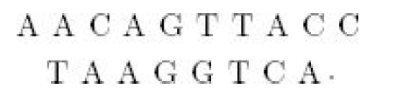
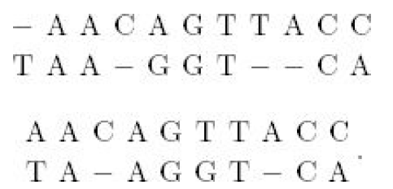
3.7. Sequence Alignment
An application of a dynamic programming to molecular genetics
  Homologous DNA sequence alignment
Adenine (A) always pairs with Thymine (T)
Guanine (G) always pairs with Cytosine (C)
In each generation, each site in the sequence has a probability of undergoing a mutation in each gamete that produces an individual for the next generation
Suppose we have the following sequences
We could align them in many ways, the following shows 2 possible alignments
The first one has 2 mismatched base pairs, inserting 4 gaps
Dash – represents ‘’inserting a gap’’
Either the deletion mutation or insertion mutation occurred

Slide 64
3.7. Sequence Alignment
Which alignment is better?
Specify the penalty for a mismatch and the penalty for a gap
Li (1997) discusses the assignment of penalties
Exercise is to write the dynamic programming algorithm for the sequence alignment problem (Waterman, 1984)
This algorithm is used in sophisticated sequence alignment systems such as BLAST and DASH.

